Slide 1
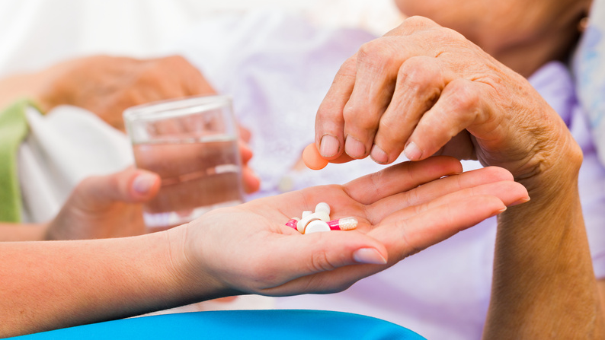
Sick Day Medications In the Elderly
Dr. Debbie Norrie

Slide 2
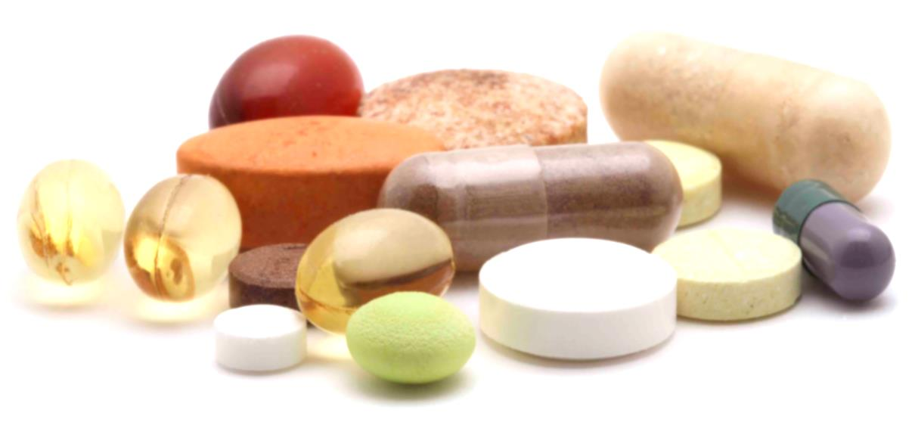
Faculty/Presenter Disclosure
Presenter: Dr. Debbie Norrie
Relationships with commercial interests: None
Notes:
This slide must be visually presented to the audience AND verbalized by the speaker.

Slide 3
Disclosure of Commercial Support
No commercial support
No potential for conflict of interest
Notes:
This slide must be visually presented to the audience AND verbalized by the speaker.

Slide 4
Mitigating Potential Bias
Not applicable
Notes:
This slide must be visually presented to the audience AND verbalized by the speaker.

Slide 5
Goals of Presentation
Review physiological changes in the elderly predisposing to medication harm
Sick Days: which medications do we withhold?
Why withdraw medications in our elderly population?

Slide 6
Goals of Presentation
Introduction of Ian Scott’s 10 step approach to withdrawal of medication
Provide examples of groups of medications to consider withdrawing
Provide resources to aid withdrawal of medications in the elderly

Slide 7
Physiological Changes in the Elderly
Pharmacokinetics: How a body processes a specific drug
Pharmacodynamics: How a specific drug affects the body

Slide 8
Pharmacokinetics
Absorption (reduced GI motility and blood flow, reduced gastric acid secretion, antacids and PPIs, first pass metabolism)
Notes:
Reduced motility increases time of drug in gut, increased absorption: decreased acid secretion may decrease absorption, absorption of drugs that undergo first pass met may be increased in older people (nitrates and propranolol)
Distribution: where drug goes after it enters bloodstream ie after absorption and first pass metabolism

Slide 9
Pharmacokinetics
Distribution (theoretical calculated volume of distribution in the tissues of the body, some drugs widely distributed into tissues, body fluids and into the CNS, influenced by protein binding, pH, molecular size, and water or lipid solubility, aging causes decreased muscle mass, and increased proportion of body fat, reduction in total body water, less albumin, risk of drug toxicity if distribution volume decreased and loading dose decreased in elderly)
Notes:
Reduced motility increases time of drug in gut, increased absorption: decreased acid secretion may decrease absorption, absorption of drugs that undergo first pass met may be increased in older people (nitrates and propranolol)
Distribution: where drug goes after it enters bloodstream ie after absorption and first pass metabolism

Slide 10
Pharmacokinetics
Metabolism (liver: synthesizes proteins, substrates, enzymes and converts chemicals from one form to another, oxidation uses CYP 450 enzymes: many drug-drug interactions can occur, conversion of drugs to active form of the drug, if half life of drug is prolonged, potential for ADRs, if half life sped up, effectiveness reduces, hepatic blood flow reduced, drug introduced to liver at a lower rate, liver mass and metabolic activity reduced, need to reduce doses of hepatically cleared drugs in elderly

Slide 11
Pharmacokinetics
Elimination (kidney: as renal function decreases, half life of drug increases, reduction in blood flow to kidneys, decrease kidney mass, reduction in size and number of functional nephrons, eGFR is a calculated estimation of renal function, but in elderly a low serum creatinine may not be indicative of normal renal function but rather a reduction in muscle mass, also amputations, ms wasting, malnutrition, may need a 24 hour urine creatinine)

Slide 12
Pharmacodynamics
Aging may increase or decrease the number of receptor sites or the affinity of receptors for a drug (i.e. Beta blockers)
Especially significant in cardiac drugs or CNS drugs
Anticholinergics may cause urinary retention which is a problem with co-morbidity of BPH
Elderly patients are more prone to CNS ADRs: dizziness, sedation, seizures and confusion
Elderly patients more vulnerable to renal toxicity with decreased renal mass and function

Slide 13
Sick Days
Definition:
Any time the patient has been sick or had a fever for 2 days and is not getting better
Vomiting or diarrhea for more than 6 hours

Slide 14
Canadian Diabetes Association Sick Day Medication list
Illness which results in decreased fluid balance (decreased intake, vomiting, diarrhea)
Increase risk for decline in kidney function
Reduced clearance and increased risk for adverse effects

Slide 15
Mnemonic for Medications to Hold on Sick Days
S Sulfonylureas
A ACE-inhibitors
D Diuretics, Direct renin inhibitors
M Metformin
A Angiotensin receptor blockers
N NSAIDS

Slide 16
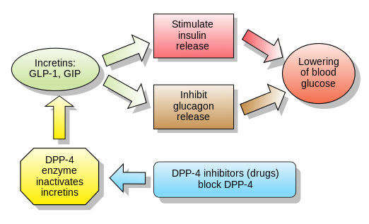
Newer Oral Anti-hyperglycemics

Slide 17
Incretin-mechanism Drugs
DPP-4 inhibitors
onglyza, trajenta, januvia
can be used in renal impairment but is dose adjusted with Cr Cl <50 (for januvia and onglyza)
GLP-1 receptor agonists
victoza
Contra-indicated in moderate to severe renal impairment, may cause renal impairment requiring dialysis when patient dehydrated

Slide 18
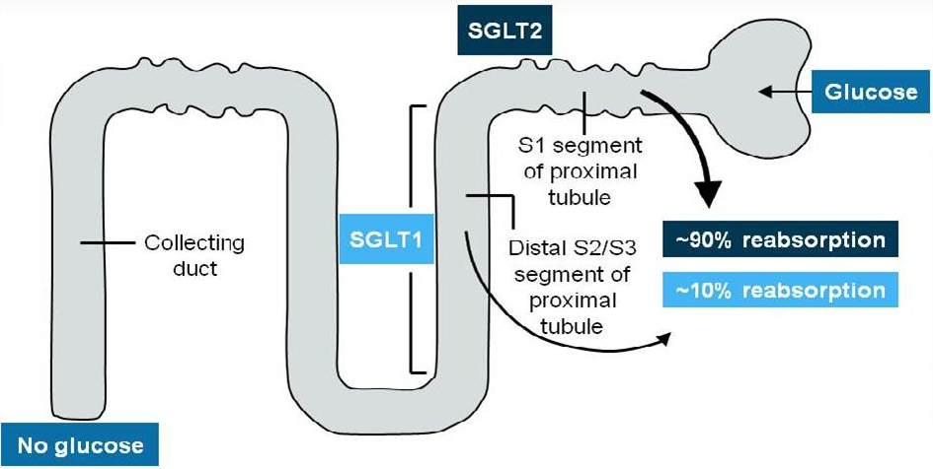
SGLT2 Inhibitors (forxiga, invokana, jardiance)

Slide 19
SGL2 Inhibitors
Block resorption of glucose at the proximal tubule
Work better when kidney function is normal, dependent on flow through the tubule
Decreased effect in dehydration, risk of renal impairment
Forxiga (Cr Cl >60)
Invokana (Cr Cl>45, dose adjust 45-60)
Jardiance (Cr Cl>45)

Slide 20
Withdrawal of Medications in the Elderly
Context:
Many of my patients in outpatient practice are becoming the oldest old (age 85 yrs.+)
I cover a floor of 32 patients in a LTC facility and many of these are frail elderly

Slide 21
Withdrawal of medications in elderly
Considerations:
Medications have often lost indication for use
Not studied in age group due to comorbidities or use of other drugs which cannot be stopped
Adverse Drug Reactions (ADR)
Drug-Drug Interactions
Drug-Disease Interactions
Compliance
Notes:
As the number of medications used increases, the number of ADRs increases, also number of drug-drug interactions

Slide 22
Withdrawal considerations (cont’d)
Pts age 60-79 fill an average of 35 prescriptions per year
Pts over age 80 fill an average of 74 prescriptions per year (Canada 2002)
Dosage and duration may be inappropriate
Medication errors occur at transitions in care (hospital to home, home to LTC)
Notes:
(Division of Aging and Seniors health Canada. Canada’s aging population. Ottawa (On): Minister of Public works and Government Services, Canada;2002)

Slide 23
Why More Adverse Drug Reactions?
Risk of an ADR is estimated to be 20%
Risk of an ADR requiring hospitalization in elderly 10.7% c/t 5.3% in general population
Higher prevalence of chronic and multiple medical conditions leading to polypharmacy
Increased number of meds in elderly makes them more prone to increased number of ADRs

Slide 24
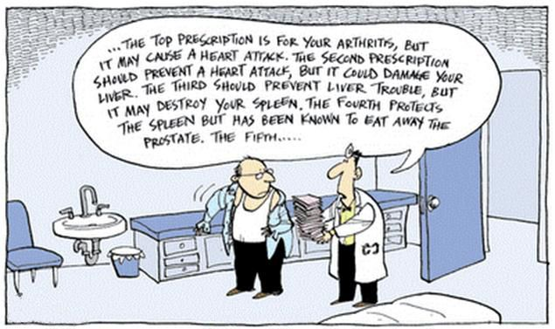
Prescribing cascade

Slide 25
Why More Adverse Drug Reactions?
Physiological changes
Decreased reserve in body system to adapt to change
Increased risk of falls, prescribing cascades, cognitive impairment (delirium and dementia)
Exclusion from pharmaceutical research (is the drug really safe in this population?)

Slide 26
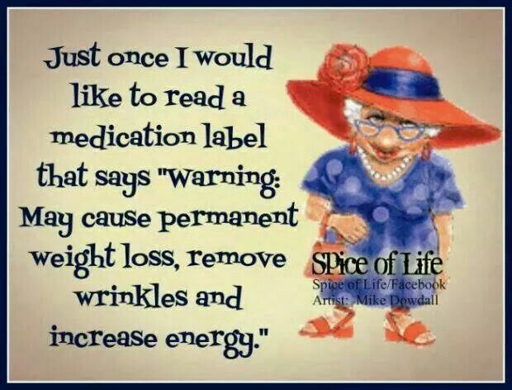
Adverse Drug Reactions

Slide 27
Drug Interactions
Drug-Drug interactions
(warfarin and macrolides, warfarin and anti-platelet agents, lipitor and nexium,)
Drug-Disease interactions
(prednisone in diabetes, prednisone in osteoporosis, anticholinergics and constipation, antipsychotics and Parkinsonism, NSAIDs and HTN, anticholinergics and BPH)

Slide 28
Patient compliance
Affected by multiple factors: Understanding, communication, language, social and cultural issues, financial, education, mental health, dementia
Brown bag visits

Slide 29
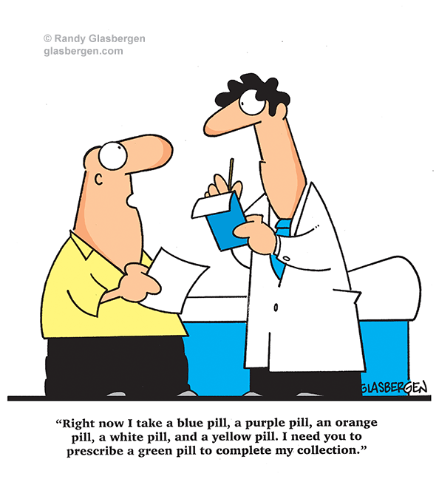
Brown Bag Assessment

Slide 30
Ian Scott 10 Steps to Deprescribing in the Elderly
List all current medications
Identify patients at risk of ADRs
Estimate life expectancy
Define overall care goals
Verify current indications for treatments
Notes:
Brisbane

Slide 31
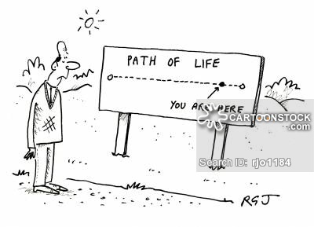
Estimate Life Expectancy

Slide 32
Ian Scott 10 Steps to Deprescribing in the Elderly
Determine need for disease-specific preventive medications
Determine absolute benefit-harm thresholds of medications (NNT, time to benefit)
Review relative utility of individual drugs
Identify drugs to be discontinued and seek patient consent
Devise and implement discontinuation plan with close monitoring

Slide 33
Medication Groups
Medications that keep patient well and improve day to day quality of life: analgesic, thyroxine, anti-anginal
Medications that are for prevention of illness in the future: statins, aspirin, warfarin, bisphosphonates

Slide 34
Trial of Discontinuation
Target drugs to be discontinued (ADRs, unclear indication, high risk in elderly)
Taper or stop only one medication at a time
Patient feels better
Patient feels the same
Patient feels worse (initiate safer drug)

Slide 35
Drug Classes to Consider Discontinuing
Cholinesterase Inhibitors
Proton Pump Inhibitors
Bisphosphonates
Benzodiazepines
Statins
Anti-hypertensives

Slide 36
Cholinesterase inhibitors
Donepezil, rivastigmine and galantamine approved and covered for Alzheimer's Disease but no other indications, MMSE 10-26
Recall that these medications show a modest benefit in mild to moderate AD and a slowing of decline in moderate to severe AD (cognitive, ADLs, IADLs, behaviours)
Notes:
Behavioural and psychological symptoms of dementia

Slide 37
Cholinesterase inhibitors
Consider risks (nausea, diarrhea, disturbed sleep, weight loss, agitation, muscle cramps, urinary incontinence) vs benefits and goals of care, consider functional benefits like self feeding
Patients are less likely to deteriorate on withdrawal of drug if no hallucinations and delusions
Notes:
Behavioural and psychological symptoms of dementia

Slide 38
Proton Pump Inhibitors
Increased infection (pneumonia and C. Diff)
Potential increases in bone fracture rates, hyponatremia and hypomagnesemia, low folate, calcium and B12
Taper doses to avoid rebound hypersecretion of gastric acid (half dose for 4-8 weeks, then stop)
Trial of antacids, alginates, lifestyle change

Slide 39
Bisphosphonates
Check for valid indication for treating (in the past we treated at lower risk levels)
Has treatment been for 5 yrs. or more? Studies show improved BMD and decreased fractures for 5 yrs., Bisphosphonates will stay in bones for years
Risks vs benefits (able to sit up and remain upright, difficulty swallowing?) Actonel DR can be taken with food.
Notes:
Alendronate = fosamax prolia: women with failed bisph (428) or contraind bisph(429) + 2/3, age >75, fragility fracture, BMD <-2.5, flex trial, horizon trial (alendronate and zoledronic acid), follow up after discontinuation

Slide 40
Bisphosphonates
If low risk of falls, is it needed? If bed bound, is treatment needed?
No need to taper with alendronate
Consider switch to prolia (denosumab) after 5 yrs. of bisphosphonates
Prolia has an LU code for women only
Notes:
Alendronate = fosamax prolia: women with failed bisph (428) or contraind bisph(429) + 2/3, age >75, fragility fracture, BMD <-2.5, flex trial, horizon trial (alendronate and zoledronic acid), follow up after discontinuation

Slide 41
Benzodiazepines
Tolerance, dependence and increased risk of adverse events (falls, cognitive decline)
Transfer to equivalent daily dose of diazepam (longer acting) at bedtime
Reduce diazepam dose every 2-3 weeks, if withdrawal symptoms, hold at this dose until resolved
Reduce further in smaller steps (may take 4 weeks to a year)
Withdrawal effects common
Notes:
W/D: insomnia, anxiety, loss appetite and body wt, tremor, perspiration, tinnitus, perceptual disturbances

Slide 42
Statins
Stop in palliative patients, no taper necessary
Otherwise, base on individual benefit and risk assessment
Stopping may be justified due to short life expectancy, low risk of CV event, adverse effects, falling
PROSPER study was done with subjects aged 70-82 with either history of CV disease and stroke or risk factors for same. Showed decreases in Coronary death, and non fatal MIs at 3 years
Notes:
Pravastatin 40 vs placebo, no effect on stroke, no effect on cognition or disability, excluded if cognitive decline

Slide 43
Anti-hypertensives
Is there still an indication?
Safe targets for BP in elderly (>150/90)
Alternative therapies (i.e.: compression stocking instead of loop diuretic)
B blockers: if started post AMI, but normal LV systolic function, no angina and not needed for hypertension or dysrhythmia, probably only beneficial for first year post AMI (use gradual dose reduction to avoid adverse withdrawal effects)
B blockers, ACE-I, CCBlockers should be tapered
Notes:
http://www.ncbi.nlm.nih.gov/pmc/articles/PMC3394111/ Beta Blocker Use After Acute Myocardial Infarction.., Current Cardiology Reviews, 2012, 8, 77-84

Slide 44
American Geriatric Society 2015 Updated Beers Criteria
Lists of potentially inappropriate medications to be avoided in older adults
New list of drugs to avoid or dose adjust for decreased kidney function
New list of drugs to avoid based on drug-drug interactions
Not applicable to those in palliative care
Companion paper of Alternative Suggestions
Grouped by organ systems

Slide 45
STOPP START Tool
Medications for patients 65 and over
British
18 Geriatricians originally
Grouped in British National Formulary Chapters categories

Slide 46
The Ottawa Top Ten Tool: Drug Classes to Avoid in the Elderly
Created after review of other tools and criteria for possibly inappropriate medications
Applicable in Canada
Arranged in drug categories
Concentrates on common high risk drugs

Slide 47
Anticholinergic Load in the Elderly
Central adverse effects (Falls, dizziness, confusion
Peripheral adverse effects (dry mouth, dry eyes, constipation)
Hospitalizations
Loss of independence
Cognitive dysfunction/delirium

Slide 48
Modified Anticholinergic Scale
3 Points
Amitriptyline
Atropine/scopolamine
Benztropine
Chlorpromazine
Clomipramine
Dicyclomine
Diphenhydramine
Doxepin
Fluphenazine
Flurazepam
Hydroxyzine
Hyoscyamine products
Imipramine
Meperidine
Nitrazepam
Oxybutynin
Perphenazine
Solifenacin
2 Points
Amantadine
Baclofen
Cetirizine
Cimetidine
Clozapine
Cyclobenzaprine
Desipramine
Loperamide
Loratadine
Nortriptyline
Olanzapine
Prochlorperazine
Pseudoephedrine
Tiprolidine
Tolterodine
1 Point
Carbidopa-levodopa
Entacapone
Haloperidol
Methocarbamol
Metoclopramide
Mirtazapine
Paroxetine
Pramipexole
Quetiapine
Ranitidine
Risperidone
Selegiline
Trazodone
Ziprasidone
Source: Adapted from Rudolph et al.24

Slide 49
Resources
American Geriatrics Society 2015 Updated Beers Criteria for Potentially Inappropriate Medication Use in Older Adults, J Am Geriatr Soc 63:2227-2246, 2015.
Alternative Medications for Medications in the Use of High-Risk Medications in the Elderly and Potentially Harmful Drug-Disease Interactions in the Elderly quality Measures; J Am Geriatr Soc 63:e8-e18, 2015.
Deciding when to stop: towards evidence-based deprescribing of drugs in older populations; Evid Based Med August 2013, volume 18,number 4:121-124, 2012.
Reducing Inappropriate Polypharmacy : The Process of Deprescribing, JAMA Intern Med.doi:10.1001/jamainternmed.2015.0324.

Slide 50
Resources
STARTing and STOPPing Medications in the Elderly, http://www.ngna.org/_resources/documentation/chapter/carolina_mountain/STARTandSTOPP.pdf
STOPP START Toolkit Supporting Medication Review, http://www.cumbria.nhs.uk/ProfessionalZone/MedicinesManagement/Guidelines/StopstartToolkit2011.pdf

Slide 51
Resources
Sick Day medication List, http://guidelines.diabetes.ca/CDACPG_resources/Appendices/Appendix_7.pdf
Ottawa Top Ten Tool, http://canadiangeriatrics.ca/default/index.cfm/linkservid/86F27E6A-B4AE-C03B-7BC1839EF84D70A1/showMeta/0/
Modified Anticholinergic Risk Scale, http://www.canadiangeriatrics.ca/default/index.cfm/linkservid/86F27E6A-B4AE-C03B-7BC1839EF84D70A1/showMeta/0/

Slide 52
Resources
Drugs to be avoided in patients with long QT syndrome: focus on the anaesthesiological management, http://www.ncbi.nlm.nih.gov/pmc/articles/PMC3653016/

